Slide 1
INTERNET AND WEB PAGE DESIGNING
WORLD WIDE WEB
(WWW)

Slide 2
What is World Wide Web?
World Wide Web, which is also known as a Web, is a collection of websites or web pages stored in web servers and connected to local computers through the internet. These websites contain text pages, digital images, audios, videos, etc. Users can access the content of these sites from any part of the world over the internet using their devices such as computers, laptops, cell phones, etc. The WWW, along with internet, enables the retrieval and display of text and media to your device.

Slide 3
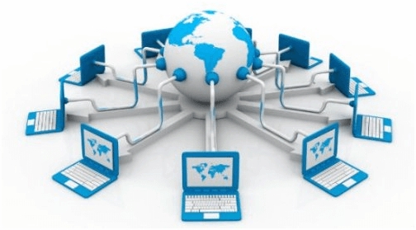
The building blocks of the Web are web pages which are formatted in HTML and connected by links called "hypertext" or hyperlinks and accessed by HTTP. These links are electronic connections that link related pieces of information so that users can access the desired information quickly. Hypertext offers the advantage to select a word or phrase from text and thus to access other pages that provide additional information related to that word or phrase.
A web page is given an online address called a Uniform Resource Locator (URL). A particular collection of web pages that belong to a specific URL is called a website, e.g., www.facebook.com, www.google.com, etc. So, the World Wide Web is like a huge electronic book whose pages are stored on multiple servers across the world.
Small websites store all of their WebPages on a single server, but big websites or organizations place their WebPages on different servers in different countries so that when users of a country search their site they could get the information quickly from the nearest server.

Slide 4
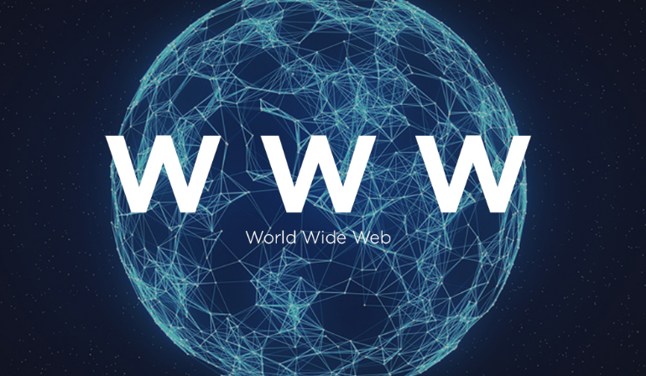

Slide 5
HISTORY OF THE WORLD WIDE WEB:
The World Wide Web was invented by a British scientist, Tim Berners-Lee in 1989. He was working at CERN at that time. Originally, it was developed by him to fulfill the need of automated information sharing between scientists across the world, so that they could easily share the data and results of their experiments and studies with each other.
CERN, where Tim Burners worked, is a community of more than 1700 scientists from more than 100 countries. These scientists spend some time on CERN site, and rest of the time they work at their universities and national laboratories in their home countries, so there was a need for reliable communication tools so that they can exchange information.

Slide 6

Internet and Hypertext were available at this time, but no one thought how to use the internet to link or share one document to another. Tim focused on three main technologies that could make computers understand each other, HTML, URL, and HTTP. So, the objective behind the invention of WWW was to combine recent computer technologies, data networks, and hypertext into a user-friendly and effective global information system.

Slide 7
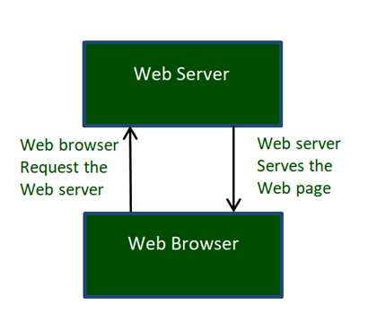
HOW THE WORLD WIDE WEB WORKS?
Now, we have understood that WWW is a collection of websites connected to the internet so that people can search and share information. Now, let us understand how it works!
The Web works as per the internet's basic client-server format as shown in the following image. The servers store and transfer web pages or information to user's computers on the network when requested by the users. A web server is a software program which serves the web pages requested by web users using a browser. The computer of a user who requests documents from a server is known as a client. Browser, which is installed on the user' computer, allows users to view the retrieved documents.

Slide 8
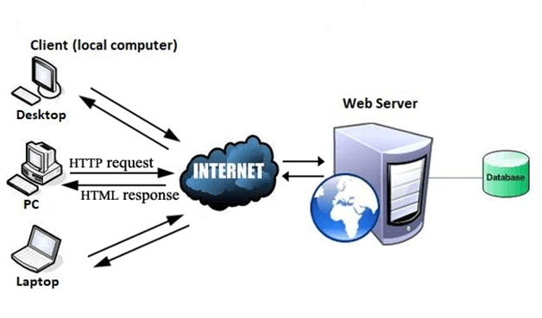
All the websites are stored in web servers. Just as someone lives on rent in a house, a website occupies a space in a server and remains stored in it. The server hosts the website whenever a user requests its WebPages, and the website owner has to pay the hosting price for the same.
The moment you open the browser and type a URL in the address bar or search something on Google, the WWW starts working. There are three main technologies involved in transferring information (web pages) from servers to clients (computers of users). These technologies include Hypertext Markup Language (HTML), Hypertext Transfer Protocol (HTTP) and Web browsers.

Slide 9
IMPORTANCE AND 10 USES OF WWW (WORLD WIDE WEB)
uses of the World Wide Web or WWW are:
1.For Communication
2.Online conference call or live meetings
3.Students may also use for online classes or learning
4.Get News worldwide instantly (24X7)
5.Watching videos for entertainment
6.Use of WWW sites for professional work
7.Uses of WWW internet for Publicity and Advertising
8.Researching something on the internet.
9.Selling products online
10.Can grow business via online

Slide 10


